Slide 1


Sales Compensation Practices
Survey Report – 2013 - 2014
October, 2013
Concord, MA

Slide 2
Table of Contents
        Page
Overview of the Survey and Participants’ Profile 3
The Structure of Sales Compensation Plans 11
  Direct Sales Executive
  Account Manager
  Distribution/Channel Manager
  Inside/Tele Sales Representative
  First Level Sales Management
Comparison of Sales Plan by Market Segment 52
  By Industry
  By Company size
Assessment of the Effectiveness of These Plans 66
Primary Conclusions and Ideas to Consider 74
Overview of the Wilson Group 76
Notes:
2

Slide 3
PART I
Overview of the Survey and Participants Profile
Notes:
3

Slide 4
I. Overview of the Survey and Participants Profile
Overview of the Survey
This survey was created to fill an important gap in information about sales compensation plans. While traditional compensation surveys show how much people make in various positions, there is usually little specific information on how companies structure their sales compensation plans. Further, as companies consider changes in their business and sales strategies, it is often very important to re-examine the sales compensation plan so that it aligns effectively with the firm’s strategy. Finally, as companies face a more competitive environment, how people are paid is as important as how much. Hopefully, this survey report provides information and insights on how companies structure their sales programs and the relationship between pay and performance.
Based on the results of this survey, several of the most important findings include:
  Approximately 77% of the participating companies made changes to their plans for 2013. Over one-third (34%) made moderate the major changes. Most of these changes included: Simplifying the plan, changing the commission rates, and placing more emphasis on acquiring new accounts or customers.
  The pay mix of the survey positions averaged around 60% for base salary and 40% for variable pay. The mix ranged from 57% salary 33% variable for direct sales to 72% salary and 28% variable for channel managers.
  Payout levels before target (100% quota) declined in relation to the performance; payout levels above target accelerated well above the actual performance. On average, payouts for exceptional performance was 1.8x that of the payout at target.
  There was little consistency among the companies about when payouts are earned and paid. Slightly less than one-third (30%) award commission when the product is shipped or delivered, and 28% do this when the sale is booked. Some companies do this when invoiced (17%) and others when invoiced are paid (17%). One-third use a combination.
  Companies feel the sales compensation plan’s best features are the compensation levels is produced (opportunity and total pay), the simplicity of the plan, and how the plan has no caps on earnings.
Notes:
4

Slide 5
I. Overview of the Survey and Participants Profile
Overview of the Survey (continued)
We hope that you enjoy this report and find it easy to understand and obtain information on how to most effectively design your sales incentive plans. If you have any questions or would like to discuss how your company compares to the market practices, please contact us. We look forward to being of service to you. Our phone number is 978-371-0476 or contact Tom Wilson at twilson@wilsongroup.com. Thank you, and enjoy the report.
Important: This report is intended for the survey participants and those that purchase the survey from the Wilson Group. All rights are reserved. This report may not be duplicated or distributed in any fashion without prior written approval from the Wilson Group to individuals outside the survey participants or purchasers of the survey. If you would like permission, please contact us at: 978-371-0476 or at Lnivison@wilsongroup.com
©Wilson Group, Inc.

Slide 6
I. Overview of the Survey and Participants Profile
Demographics: Profile of the Participating Companies
The survey includes information from 26 companies. The companies primarily come from four industries – technology (25% ), consumer products/retail, professional services/communication, and manufacturing which all had the same number of participants (18% each). Other industry segments included bio-technology and insurance (each with 11%).
These companies were primarily privately held (61%) companies and approximately one-third were public companies (32%). Others were either not-for-profit or subsidiaries of non-US companies. Many of the companies are considered mid-market (median revenues of $272M) and four companies had revenues over $1B. Approximately 8% of the employees are in the sales function, and the total compensation to sales people reflects on average 16% of total payroll in these companies (the 25th Percentile was 7% and the 75th Percentile was 38%).
Demographics:
Median 25th Percentile 75th Percentile Average
Annual Revenues: $272 M $205M $420M $624M
Total No. of EEs: 870 140 2,473 1,947
Total payroll: $ 53M $ 19M $154M $104M
Number of sales EEs: 50 28 110 170
(average of 8% of the overall workforce) (the high average was due to a few participants with a large salesforce.)
Total sales comp: $ 5.5M $ 1.3M $ 22.5M $ 24M

Slide 7
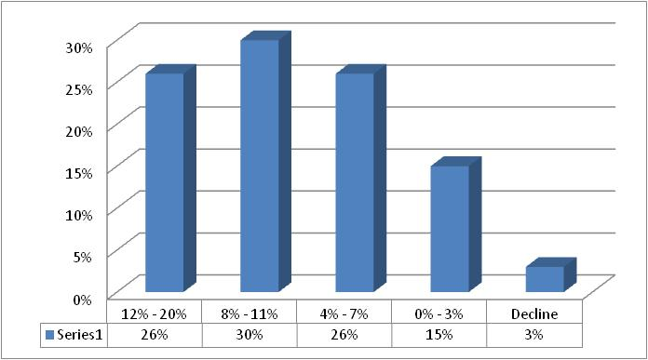
I. Overview of the Survey and Participants Profile
Demographics: Revenue growth projections for 2013
This group of companies is clearly in a growth mode. Approximately 82% have revenue growth projections for 2013 that exceeded 7% over 2012. Only one organization was forecasting a decline in sales.
In terms of staffing, 41% of the companies were increasing the number of sales people, 52% were making no change to the staffing level, and 4% were decreasing the staffing levels. This pattern shows that companies on balance are looking to increase revenues between 10% and 15% using the same number of sales professionals in their organization.
Revenue growth projections for 2013

Slide 8
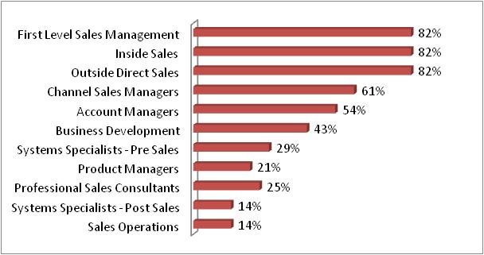
I. Overview of the Survey and Participants Profile
Positions Included in Sales Compensation Plans
The table below shows the percent of companies that have one or more positions included in their sales compensation plans. Obviously, the first level of sales managers, those in direct sales and direct inside sales are included in a sales incentive plan for most of the companies. Approximately half include channel or indirect sales managers, account manager, and business development sales in their sales compensation plans. There were no consistent patterns of who is included or excluded by industry. Most of the eligibility tended to reflect the organization of the sales function rather than the industry practices. More pre-sales systems specialists were included in the sales plans than post-sales specialists. Few companies applied sales incentive plans to their sales operations jobs.

Slide 9
I. Overview of the Survey and Participants Profile
Eligibility for Merit Pay and Equity based Compensation
Furthermore, 58% of the companies provide annual merit pay review and increases, similar to the way they handle other employees. Twenty-three (23%) percent provide increases on an as needed basis to retain competitiveness and 15% provide periodic market adjustments only. Only one company indicated that they were giving merit raises that were less than the standard employee raise.
Finally, few sales professionals are eligible to receive equity based awards in the participating companies. The following table shows the type of equity vehicle utilized for long-term incentive awards and the percent of companies using this vehicle for each sales job covered in the survey:

Slide 10
I. Overview of the Survey and Participants Profile
List of Survey Participants
A.W. Chesterton
Analog Devices
Ariel Group, LLC
Bose Corporation
Boston Mutual Insurance Company
Circor International
Collette Vacations
Constant Contact
CoreXchange
Data I/O Corporation
Deluxe Corporation
DentaQuest
Excelitas Technologies
J.J. Haines
Keystone Dental
Keystone Partners
MorphoTrust USA
New Balance Athletic Shoe, Inc.
New England Media Group (Boston Globe)
Nora Systems, Inc.
Pegasystems
PEMCO Mutual Insurance Co.
SAVANT
Smith & Nephew
Stratus Technologies
Systagenix

Slide 11
PART II
The Structure of
Sales Compensation Plans
Notes:
11

Slide 12
II. The Structure of Sales Comp Plans
Overview of this Section
This section of the report will provide a summary of the responses for all participants. The survey examined the sales practices for five (5) positions. These are:
  Direct Sales Executive
  Account Manager
  Channel (Indirect) Manager
  Inside/Tele Sales Representative
  First Level Sales Management
This section will examine the sales compensation design elements for each of these positions. We will first provide the job profile that was included in the survey. Participants were asked to indicate their confidence (expressed as a percentage) of their job match to the job profile. The average responses of the confidence factor exceeded 90% for each of these jobs.
In the section that follows (Section III) we will examine the responses to the most critical questions, or ones where there were the most variance in responses, by industry and by company size (based on revenues).
We hope this information provides important insights to your company’s sales compensation practices as you compare them to the market.

Slide 13
II. The Structure of Sales Comp Plans – Direct Sales
Summary of the Position
The following is the position profile on which the respondents based their sales plan information:
Direct Sales Executive:
Responsible for generating new and/or existing sales from assigned territories, product lines or named accounts. Involves contacting, visiting and building relationships with prospects. Builds a network of referral sources and/or handles leads generated through the company’s marketing initiatives. Participates in analyzing the customer’s needs and opportunities, presenting products and services that can address the customer’s needs, and closing the contract agreement. Demonstrates knowledge of the organization’s products and services, and may have in-depth knowledge of a subset of products or services. This is the seasoned, mid-career level sales position. Requires a minimum of an associate's or bachelor’s degree or its equivalent with 6-9 years of experience in the field or in a related sales area. Relies on experience and judgment to plan and accomplish goals, and utilizes trained sales skills and practices consistent with the firm’s marketing and sales strategies. Typically reports to a district or regional manager or head of a unit/department.

Slide 14
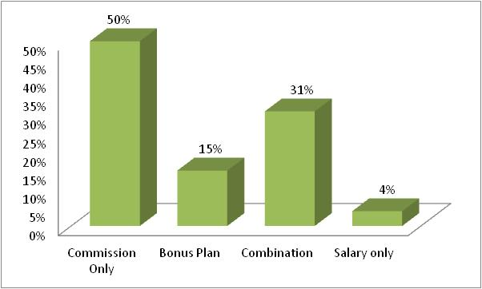
II. The Structure of Sales Comp Plans – Direct Sales
Median Total Compensation
We asked the participating companies to provide us with their median salary and on-target total cash compensation for this position. The data below shows the distribution of the compensation levels. It shows that salaries are customarily 60% of the total cash compensation at target performance, or a salary of $80,000 and total cash compensation of $140,000 for the Direct Sales Executive. The range of data provided for this position is also shown.
Type of Sales Compensation Plans Utilized
The following table shows the type of plans most common for this position. It shows that 50% of the companies utilize commission based compensation plans, and 46% provide a combination of commission and bonus plans for these sales representatives.

Slide 15
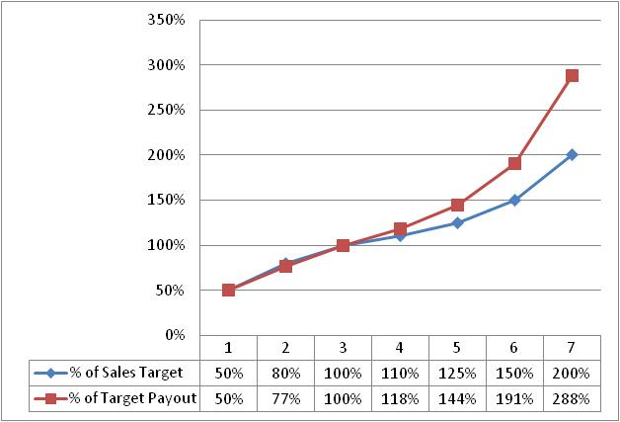
II. The Structure of Sales Comp Plans – Direct Sales
On-Target Earnings -- Performance Factors
Virtually all participants indicated that their compensation plans were based on individual performance factors. In addition to individual measures, 7% of the participants use team/group measures, another 7% use regional or overall sales performance, and 10% use corporate performance to determine the payouts.
On-Target Earnings -- Performance and Pay Relationship
In general, the targeted earnings correspond to the same level of performance (as a percent of quota or goal target). The payout below target corresponds closely to the actual performance to quota or goal, but above quota the payout accelerates to approximately 1.44 of the performance to quota.

Slide 16
II. The Structure of Sales Comp Plans – Direct Sales
Performance Distribution
The chart below shows the distribution (25th, 50th and 75th Percentile) of actual performance to sales quotas or goals. When considering all the data, only 48% of the companies indicated that in 2012 their sales executives scored above quota/goal. The distribution shows that 46% of the sales performers achieved between 85% and 125% of their goal, while 17% exceeded this level and 41% fell short of this achievement level.
The participants also reported that the payout for “Exceptional” performance was 1.7 times the target payout for meeting quota or goal.

Slide 17
II. The Structure of Sales Comp Plans – Direct Sales
Frequency of Payouts
The sales commission plans for this position are usually paid on a monthly basis, with some paying on a quarterly basis. On further examination of the data, virtually all those that have little to no base salary make their payouts on a monthly basis.
When Payouts are Made
When people are paid is a more challenging issue than how often. There is greater diversity of opinions on this design element. The table below shows the average responses for when incentive payouts are made. While most companies pay when the product is shipped or the service is delivered, the booking or contract agreement or a combination of these factors is also used by several companies. The combination frequently will pay something at the booking, and the balance when the product is shipped or delivered. Smaller companies tended to use “when collected” to address their concerns with cash flow.

Slide 18
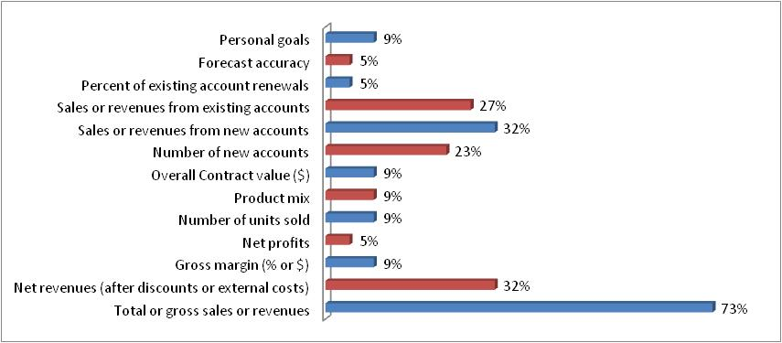
II. The Structure of Sales Comp Plans – Direct Sales
Performance Measures
The primary focus of these positions is clearly on generating sales or revenues for the company. For the Direct Sales, the emphasis tends to be on NEW accounts for many of the participating companies. The following are the performance measures used in these plans. Clearly gross sales is the predominate measure. Between 25% and 32% also use sales from existing accounts or from new accounts, as well as the number of new accounts in their sales incentive plans. This reflects the importance of generating sales from existing customers as well as market share or growth from new customers.

Slide 19
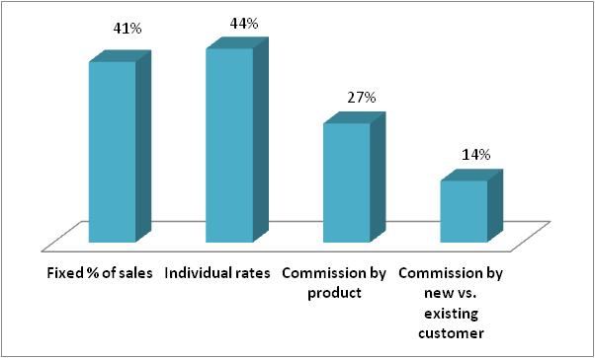
II. The Structure of Sales Comp Plans – Direct Sales
How commissions are determined
There are a wide range of practices when it comes to how commissions are determined. Approximately 44% of the participants have commission rates that are tied to the individual’s on-target earnings, where slightly less (41%) use the same rates for all sales professionals. Slightly less than one –third (27%) have commissions by product, and 14% differentiate commission rates by the type of customer – new versus existing.
When performance begins earning income
Approximately 81% of the participating companies start paying commission on the first dollar of sales. The remaining 19% start paying commission once a threshold level of sales is achieved. For these companies in particular, there is a base salary that is established, and the threshold is intended to “pay for” the base salary.

Slide 20
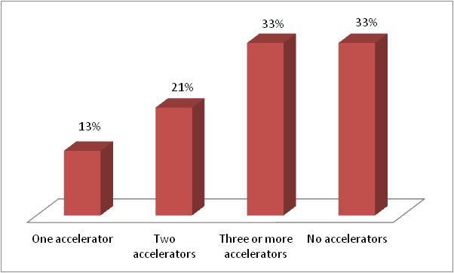
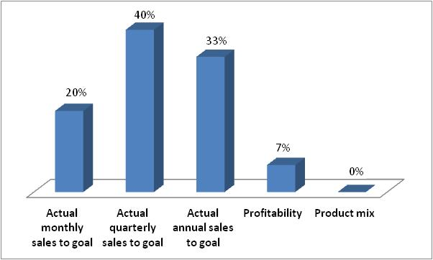
II. The Structure of Sales Comp Plans – Direct Sales
Commission accelerators -- Prevalence
Most companies (67%) do provide an accelerator to their commission rates. When accelerators (i.e., an increase in the commission rate) are used, there tends to be 3 or more points of acceleration.
Commission accelerators -- Triggers
For those companies that use accelerators for their commission rates, most increase the rate based on sales performance achievements on a quarterly or annual basis.

Slide 21
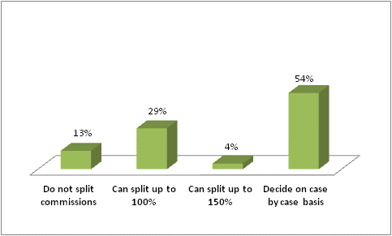
II. The Structure of Sales Comp Plans – Direct Sales
Use of thresholds, caps or decelerators on sales income
Of the companies reporting the use of thresholds before commission are paid, the average percent of sales quota was 78%. The range was from 50% to 90%. Approximately 80% do not use caps on sales commission earned. Two of the respondents indicated they decelerate the commission rates above a certain level.
Splitting sales credits
From time to time, a sale may involve more than one person. Since most of these sales plans are based on individual performance, how does a company reinforce collaboration on the sale? In this group of companies, several enable the sales people to split the current sales commission based on the contribution to achieving the sale, while the majority decide this on a case by case basis.

Slide 22
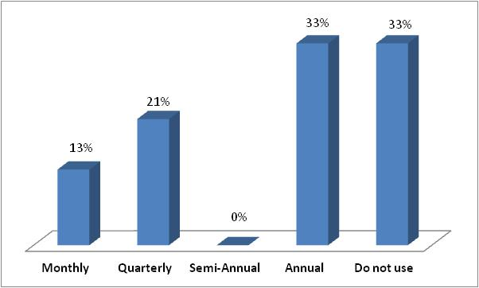
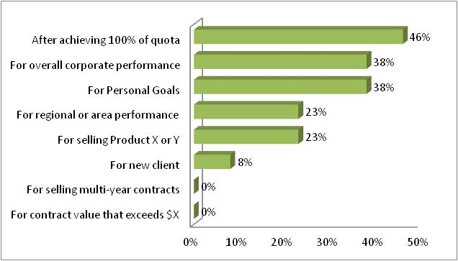
II. The Structure of Sales Comp Plans – Direct Sales
Bonus Plans – Frequency of payouts
As noted earlier in this report, approximately 60% of companies have a bonus plan as part of their sales incentive plan (15% have bonus only and 31% use a combination of commissions and bonuses). Approximately 2/3rd of this group make bonus payouts on an annual basis and 21% make payouts on a quarterly basis. A few companies make these payouts on a monthly basis.
Bonus Plans – Performance measures
Approximately one quarter of the survey participants make bonus payouts associated with meeting sales quotas and another quarter use bonuses to reward personal performance goals.

Slide 23
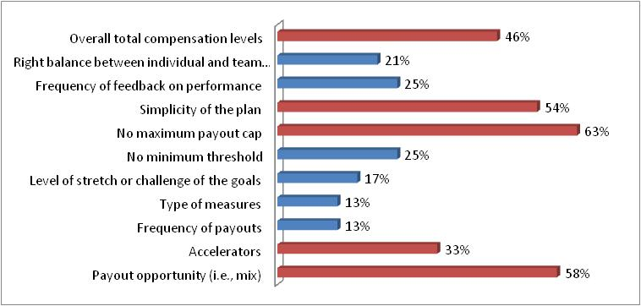
II. The Structure of Sales Comp Plans – Direct Sales
Most important and effective elements of the sales compensation plan
“Best Practices” are hard to define particularly in a highly volatile marketplace. So we asked the participants to tell us what they believe are the most important elements of their sales compensation plans, what makes it an effective program. While there was little consensus on the elements, the most important factors seem to be:
(1) No maximum payout or cap to the plan
(2) The payout opportunity
(3) The simplicity of the plan
(4) The overall total compensation levels
(5) The use of accelerators to the commission rates

Slide 24
II. The Structure of Sales Comp Plans – Acct Mgr
The following is the position profile on which the respondents based their sales
plan information:
Sales Account Manager:
Responsible for generating sales from assigned existing accounts and retaining strong favorable relationships with their customers. Is usually responsible for developing and/or expanding existing accounts within the assigned territory, and ensures that company’s products or services consistently meet customers’ needs. This job is key to the company’s strategies for customer satisfaction and experience. May be responsible for sustaining and renewing client contracts. May require a bachelor's degree and at least 3 to 5 years of experience in the field or in a related account management area. Familiar with a variety of the sales and account management concepts, practices, and procedures. Relies on extensive experience and judgment to plan and accomplish goals. May lead and direct the work of others. Typically reports to a manager of major accounts or a district or regional manager.

Slide 25
II. The Structure of Sales Comp Plans – Acct Mgr
Median Total Compensation
We asked companies to provide us with the salary and on-target total cash compensation for this position. The data below shows the distribution of the medians of these positions. It shows that compensation mix is 75% for base salaries and 25% for incentive pay.
Type of Sales Compensation Plans Utilized
The following table shows the type of plans most common for this position. It shows clear differences between companies that have this position. There is a tendency to utilize commission plans, but other types of plans are also prevalent.

Slide 26
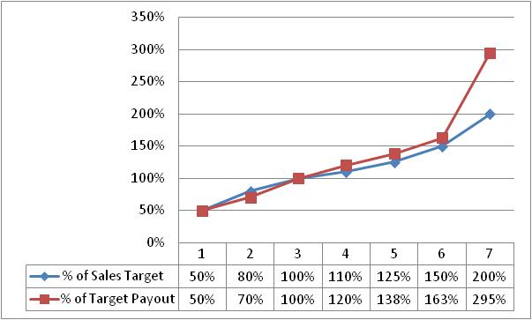
II. The Structure of Sales Comp Plans – Acct Mgr
On-Target Earnings -- Performance Factors
Virtually all participants indicated that their compensation plans were based on individual performance factors. However, a large number utilize regional or overall sales performance, team/group performance or corporate performance. This reflects the structure of these sales plans as having greater interdependency than shown for direct sales executives.
On-Target Earnings -- Performance and Pay Relationship
The targeted earnings correspond generally to the same level of performance (as a percent of quota or goal target), except when one reaches exceptional performance defined hitting or exceeding 200% of goal. The average pay and performance percentages are shown on this chart.

Slide 27
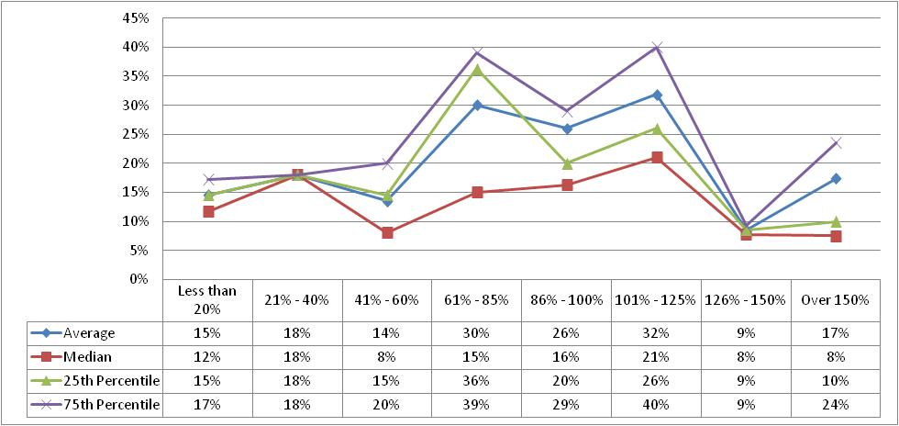
II. The Structure of Sales Comp Plans – Acct Mgr
Performance Distribution
The chart below shows the distribution (25th, 50th and 75th Percentile) of actual performance to sales quota or goal. When considering all the data, most companies (46%) indicated that their Account Managers achieved between 85% and 125% of their sales goals; and 26% of the companies indicated that in 2012 their Account Managers scored above quota/goal (101% to 150%+). The participants reported that the payouts for “Exceptional” performance were 1.86 times the target payout for meeting the performance goals.

Slide 28
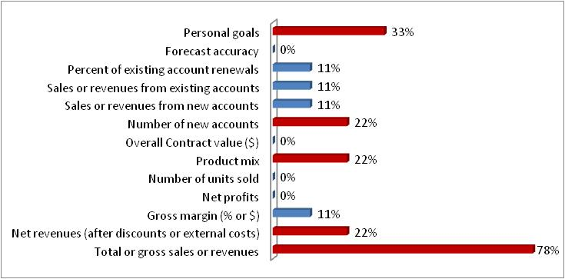
II. The Structure of Sales Comp Plans – Acct Mgr
Performance Measures
The primary focus of these positions is clearly on generating sales or revenues at or above the quota, and addressing personal goals. There is little emphasis among the survey companies that the Account Manager will be profit oriented or differentiating the sales effort between current and new customers.

Slide 29
II. The Structure of Sales Comp Plans – Acct Mgr
How and when commissions are determined
The commission rates for Account Managers vary between being based on the product or service (i.e., it is the same rate for all individuals) versus rates that are based on the individual’s performance goals and on-target earnings. Forty-two percent of the respondents indicated they use a fixed rate for commissions where 58% use a rate that is established for the individual.
There are few who use multiple accelerator rates like we saw with the Direct Sales Executive position. Those that responded to this question were evenly split between those that use only one accelerator and those that do not use accelerators at all. Further, most companies start their commission based on the first dollar sale as opposed to setting a threshold before incentive payouts can commence.
The vast majority of companies in the survey do not have caps on commissions for their Account Managers. Only one company uses caps in their survey, and another company will lower the rate of earnings after one has achieved certain performance levels above their goal.
When more than one sales person is involved, most companies decided how to split the commission on a case by case basis. Two companies enable the sales team to divide the 100% of earned commission to members of the selling team based on their level of involvement. Two companies don’t permit splitting of sales commissions.

Slide 30
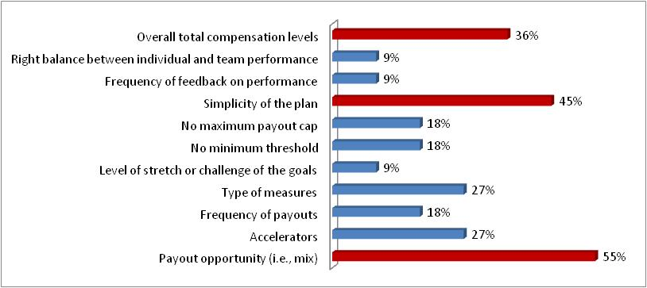
II. The Structure of Sales Comp Plans – Acct Mgr
Most important and effective elements of the sales compensation plan
“Best Practices” are hard to define particularly in a highly volatile marketplace. So we asked the participants to tell us what they believe are the most important elements of their sales compensation plans - what makes it an effective program. While there was little consensus on the elements, the most important factors seem to be (1) payout opportunity, (2) the simplicity of the plan and (3) and the competitiveness of the overall total compensation levels. The responses are shown below:

Slide 31
II. The Structure of Sales Comp Plans – Channel Mgr
The following is the position profile on which the respondents based their sales
plan information:
Indirect or Channel Sales Manager:
Responsible for generating sales of the company’s products and services that are generated through distributor, broker channels or cooperative partners within identified name distributors, territory or industry. The incumbent does not usually directly generate sales, but is responsible for revenue generation through the management of sales reps and supervisors of another sales organization. Maintains effective communications with sales managers and representatives across the company to ensure proper handling of these indirect sales or account development activities. May participate in presenting product and services to distributors or customers if needed to benefit the sales process or customers’ needs. Usually requires six to nine years of sales experience with particular expertise in distributor sales process. Demonstrates knowledge of the company’s entire product or service lines, and may have in-depth knowledge on a subset of products, services, or industry practices.

Slide 32
II. The Structure of Sales Comp Plans – Channel Mgr
Median Total Compensation
We asked companies to provide us with the salary and on-target total cash compensation for this position. The data below shows the distribution of the medians of these positions. It shows that compensation mix is approximately 70% for base salaries and 30% for incentive pay.
Type of Sales Compensation Plans Utilized
The following table shows the type of plans most common for this position. It shows that there are primarily two types of plans utilized for this position – commission only and bonus plans.

Slide 33
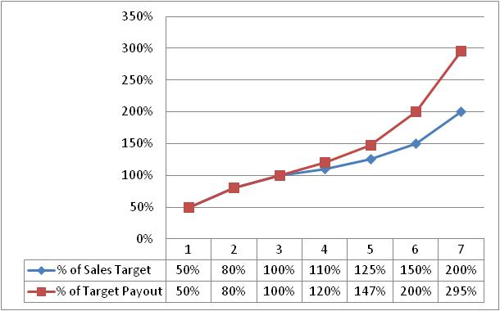
II. The Structure of Sales Comp Plans – Channel Mgr
On-Target Earnings -- Performance Factors
Virtually all participants indicated that their compensation plans were based on individual performance factors. Several companies utilize team/group performance based performance. This reflects that these positions are more similar to Direct Sales than Account Managers.
On-Target Earnings -- Performance and Pay Relationship
The targeted earnings correspond generally to the same level of performance (as a percent of quota or goal target) below the sales quota or goal. With above target payouts, the payouts increase dramatically higher than the performance targets. The respondents also indicated that at “Exceptional” performance, the payout is 200% of the payout at target level of performance.

Slide 34
II. The Structure of Sales Comp Plans – Channel Mgr
Performance Distribution
The chart below shows the distribution (25th, 50th and 75th Percentile) of actual performance to sales quota or goal. When considering all the data, most companies (45%) indicated that their Channel Managers achieved sale quota/goals, and 18% of the companies indicated that in 2012 their Channel Managers scored above quota/goal.

Slide 35
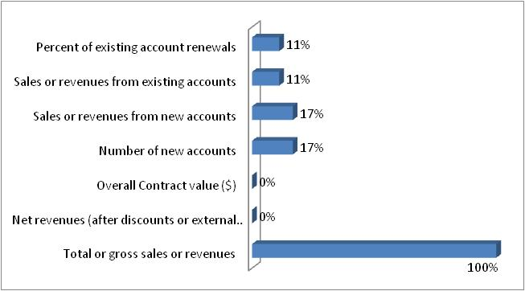
II. The Structure of Sales Comp Plans – Channel Mgr
Frequency of Payouts
Most sales commission plans for this position are paid on a monthly basis, with some paying on a quarterly basis.
Performance Measures
The primary focus of these positions is clearly on generating sales or revenues. Similar to Direct Sales, this position is focused on overall revenues.

Slide 36
II. The Structure of Sales Comp Plans – Channel Mgr
How and when commissions are determined
There are a wide range of practices when it comes to how commissions are determined. The commission plans for most Channel Managers do not have accelerators build into their rates. Those that do, accelerate the rate when monthly or annual goals are achieved. The commission rates apply to the first dollars of sales results. Only one company used a threshold before the commission rates would apply. The threshold tended to be around 90% of the quota or sales target.
As in most other sales positions, income caps are not used. Two companies do provide caps given the indirect nature of the sales that result from the Channel Manager; one company reduces or decelerates the commission rates above a defined level. A few companies who have these positions do permit splitting of sales commission (100%) with others. In experience, this splitting are frequently with the direct sales roles when there are overlaps in the territory of the direct sales and channel partners.
Approximately one-third of these positions have a bonus plan associated with their compensation plan. These bonus plans tend to focus on achieving personal goals, or one’s regional/district/area goals or the corporation’s overall performance. One firm uses a bonus to reward goal achievement. Most of these bonuses are paid out quarterly or annually.

Slide 37
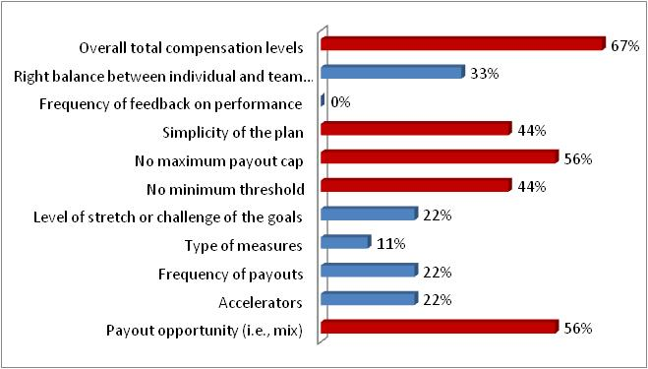
II. The Structure of Sales Comp Plans – Channel Mgr
Most important and effective elements of the sales compensation plan
“Best Practices” are hard to define particularly in a highly volatile marketplace. We asked the participants to tell us what they believe are the most important elements of their sales compensation plans - what makes it an effective program. While there was little consensus on the elements, the most important factors seem to be the following:
(1) Overall competitiveness of total compensation
(2) There is no maximum payout cap
(3) The payout opportunity
(4) The simplicity of the plan
(5) There is no minimum threshold to earn commission income

Slide 38
II. The Structure of Sales Comp Plans — Inside Sales
The following is the position profile on which the respondents based their sales
plan information:
Inside Sales Representative:
Responsible for selling the company’s products and services via telephone, email and web-based communication to customers in assigned territory, industry or accounts. This position must close the sale on the products or services. The incumbent may generate prospective customers through cold calling or referrals from marketing and advertising, or from handling customers of assigned Field Sales Representatives. Requires a strong knowledge of the products and services, and the sales tracking and order processing systems. This position may operate as part of a sales team and support direct field sales staff or operate independently. May also be responsible for renewal of contracts and agreements. It may carry a sales quota or goals related to business for new and/or existing customers. The incumbent typically has between 2 -4 years of sales experience.

Slide 39
II. The Structure of Sales Comp Plans — Inside Sales
Median Total Compensation
We asked companies to provide us with the salary and on-target total cash compensation for this position. The data below shows the distribution of the medians. It shows that compensation mix is approximately 70% for base salaries and 30% for incentive pay.
Type of Sales Compensation Plans Utilized
The following table shows the type of plans most common for this position. It shows that there are primarily two types of plans utilized for this position – commission only and bonus plans.

Slide 40
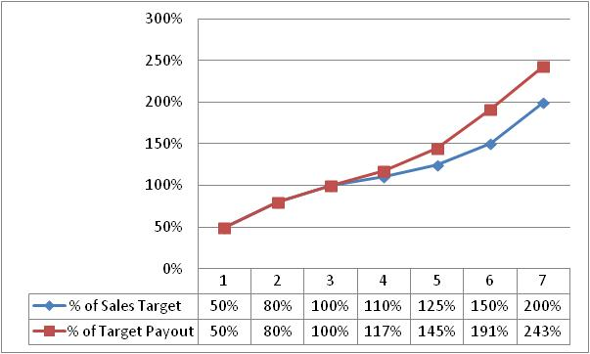
II. The Structure of Sales Comp Plans — Inside Sales
On-Target Earnings -- Performance Factors
Virtually all participants indicated that their compensation plans were based on individual performance factors. Several companies utilize team/group performance based incentives. This reflects that these positions are more similar to Direct Sales than Account Managers.
On-Target Earnings -- Performance and Pay Relationship
The targeted earnings correspond generally to the same level of performance (as a percent of quota or goal target) below the sales quota or goal. With above target payouts, the payouts increase dramatically higher than the performance targets. The respondents also indicated that at “Exceptional” performance, the payout is 185% of the payout at target level of performance.

Slide 41
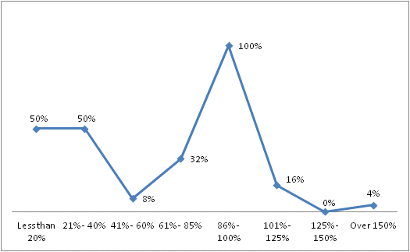
II. The Structure of Sales Comp Plans — Inside Sales
Performance Distribution
The chart below shows the distribution (median or 50th Percentile) of actual performance to sales quota or goal. When considering all the data, most companies (29%) indicated that their Inside Sales Reps achieved sale quota/goals. There was insufficient data to calculate the percentile rankings.

Slide 42
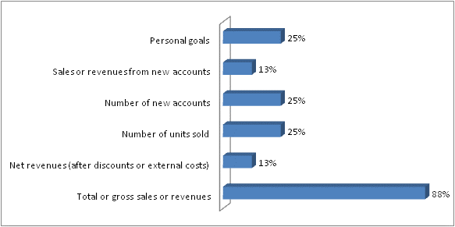
II. The Structure of Sales Comp Plans — Inside Sales
Frequency of Payouts
Most sales commission plans for this position are paid on a monthly basis, with some paying on a quarterly basis. There is no common practice for when Inside Sales Reps are compensated. Most pay these sales positions either when the order is booked or a combination of booked and delivered.
Performance Measures
The primary focus of these positions is clearly on generating sales or revenues. Similar to Direct Sales, this position is focused on overall revenues.

Slide 43
II. The Structure of Sales Comp Plans — Inside Sales
How and when commissions are determined
The sales compensation plans for Inside Sales Representatives are fairly consistent with other sales compensation plans in these participating companies. Approximately 2/3rd use a fixed commission structure and 1/3rd use a structure based on individual quotas and on-target earnings. These commission rates do not tend to have accelerators associated with them. If they do exist, they are linked to performance against one’s quarterly or annual goal. Seventy percent of the plan provide commission income from the first dollar; 30% have a threshold. The threshold averages at 75% of quota, with a range from 50% to 90%. And, like other sales plans, these compensation plans do not tend to have income earning caps.
When sales people share in the achievement of sales, most companies will decide on the commission split on a case by case basis. If there are splits, the amount is limited to the 100% of the available commission. These positions do not tend to be eligible for bonus plans.

Slide 44
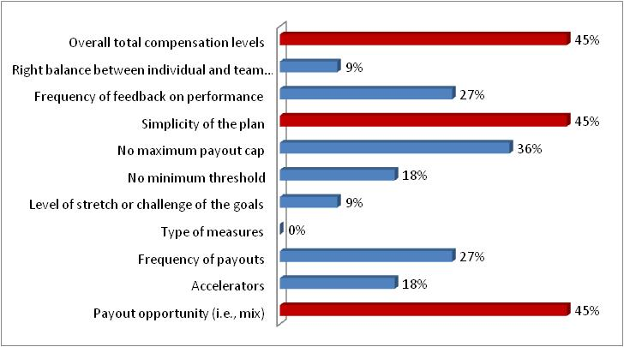
II. The Structure of Sales Comp Plans — Inside Sales
Most important and effective elements of the sales compensation plan
“Best Practices” are hard to define particularly in a highly volatile marketplace. We asked the participants to tell us what they believe are the most important elements of their sales compensation plans - what makes it an effective program. While there was little consensus on the elements, the most important factors seem to be the following:
(1) Overall competitiveness of total compensation
(2) The payout opportunity
(4) The simplicity of the plan

Slide 45
II. The Structure of Sales Comp Plans — Sales Manager
The following is the position profile on which the respondents based their sales
plan information:
First Level Sales Manager:
Responsible for the sales generated to customers in a defined geographic, product or industry segment. This position supervises Direct Sales Representatives and/or Account Managers, but does not manage other sales managers. This is the first level of direct supervision over the field sales force of the company. This work includes coaching and developing staff, handling critical customers, and overseeing the company’s sales process. The incumbent may also have responsibility for generating own sales independent of staff being supervised, and thereby may carry own sales quota. The incumbent typically has 6 – 9 years of sales experience. In an organization with a broad range of levels, please utilize the positions considered as “mid-level” within the sales organization.

Slide 46
II. The Structure of Sales Comp Plans — Sales Manager
Median Total Compensation
We asked companies to provide us with the salary and on-target total cash compensation for this position. The data below shows the distribution of the medians. It shows that compensation mix is approximately 60% for base salaries and 40% for incentive pay.
Type of Sales Compensation Plans Utilized
The following table shows the type of plans most common for this position. It shows that there are primarily two types of plans utilized for this position – commission only and a combination of combination and bonus plans.

Slide 47
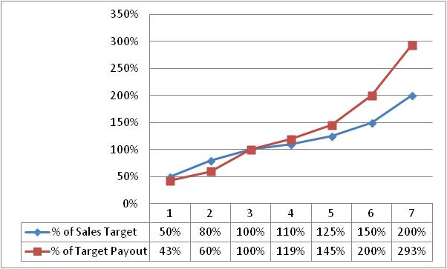
II. The Structure of Sales Comp Plans — Sales Manager
On-Target Earnings -- Performance Factors
First Level Sales Managers tend to have a mixture of performance factors impacting their compensation. Twenty-five percent (25%) of the survey companies weight individual performance 100%; 33% weight regional or area sales performance at least 90% of the value. Over 50% of the companies used at least 2 levels of organizational performance to determine the sales managers payouts.
On-Target Earnings -- Performance and Pay Relationship
The targeted earnings correspond generally to the same level of performance (as a percent of quota or goal target) below the sales quota or goal. With above target payouts, the payouts increase dramatically higher than the performance targets. The respondents also indicated that at “Exceptional” performance, the payout is 200% of the payout at target level of performance.

Slide 48
II. The Structure of Sales Comp Plans — Sales Manager
Performance Distribution
The chart below shows the distribution (median or 50th percentile) of actual performance to sales quota or goal. There was insufficient data to calculate the percentile rankings.

Slide 49
II. The Structure of Sales Comp Plans — Sales Manager
Frequency and Timing for Payouts
Most sales commission plans for this position are paid on a quarterly basis, with some paying on a monthly basis. The commissions are usually earned when the produce has been shipped or service delivered.
Performance Measures
The primary focus of these positions is clearly on generating sales or revenues. Similar to Direct Sales, this position is focused on overall revenues.

Slide 50
II. The Structure of Sales Comp Plans — Sales Manager
How and when commissions are determined
Sales managers tend to be compensated similar to their sales staff, with a few important exceptions. Those that carry quotas or are focused on direct sales tend to have a high commission basis for their compensation plans. Commissions are as likely to be fixed as they are designed to be individually quota and on-target income based. These commission plans are similar to direct sales and have multiple, two or three, acceleration points. The triggers for these accelerators are the level of performance to goal on a quarterly or annual basis. Further, the commission payments begin first dollar sales. If there is a threshold, then it tends to be around 80% of goal (the range is from 50% to 90% like other sales positions).
Most companies do not use income caps for their sales managers or other sales staff. Further, they decide on commission splits on a case by case basis.
A few companies indicated that they provide bonus opportunity to their first line sales managers. These bonuses are paid on a monthly or quarterly basis and are usually based on personal goal achievement or the performance of the overall region or area.

Slide 51
II. The Structure of Sales Comp Plans — Sales Manager
Most important and effective elements of the sales compensation plan
“Best Practices” are hard to define particularly in a highly volatile marketplace. We asked the participants to tell us what they believe are the most important elements of their sales compensation plans - what makes it an effective program. While there was little consensus on the elements, the most important factors seem to be the
(1) The payout opportunity
(2) The overall competitiveness of total compensation
(3) The simplicity of the plan
(4) No maximum payout cap on earnings

Slide 52
PART III
Comparison of Sales Plan by Market Segment
Notes:
52

Slide 53
III. Comparison by Market Segment
Comparison of most common elements:
The following tables display a comparison of the companies by industry and by company size (based on revenues). The tables on the following pages show the responses to the key questions. The tables illustrate the percent of respondents that provided data for each of the questions. For the blank spaces, there was insufficient responses to show response patterns and practices. This information should enable you to compare your industry’s responses with the current sales compensation plan design within your company.
The key questions include:
1. Total Cash Compensation -- Base salary and on-target total compensation
2. The mix of base salary and variable compensation, where base salary is shown as a percent of total cash compensation
3. The total earnings as a percent of target earnings at 7 performance levels (50% - 200% of target)
4. How the commission rates are determined
5. When two people are involved in a sale, how companies tend to share sales credit
6. The 3 - 5 most important elements of the sales compensation plans

Slide 54
III. Comparison by Market Segment – By Industry

Slide 55
III. Comparison by Market Segment – By Industry

Slide 56
III. Comparison by Market Segment – By Industry

Slide 57
III. Comparison by Market Segment – By Industry

Slide 58
III. Comparison by Market Segment – By Industry

Slide 59
III. Comparison by Market Segment – By Industry

Slide 60
III. Comparison by Market Segment – By Size

Slide 61
III. Comparison by Market Segment – By Size

Slide 62
III. Comparison by Market Segment – By Size

Slide 63
III. Comparison by Market Segment – By Size

Slide 64
III. Comparison by Market Segment – By Size

Slide 65
III. Comparison by Market Segment – By Size

Slide 66
PART IV
Assessment of the Effectiveness of These Plans
Notes:
66

Slide 67
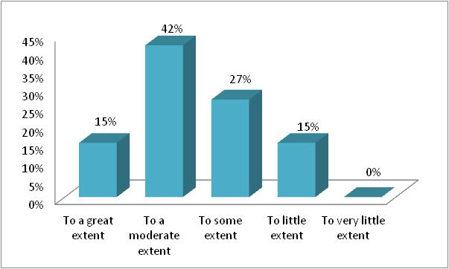
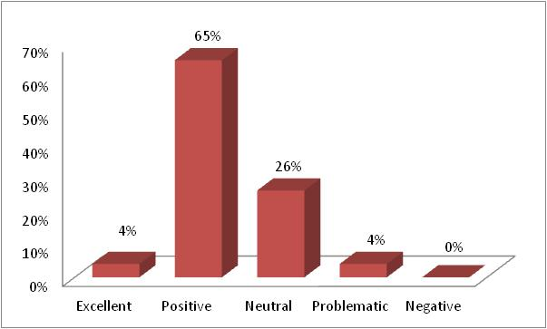
IV. Assessment of the Effectiveness
We asked the participants several questions regarding the effectiveness of their current plans from both motivational and administrative perspectives. We further asked about the type and prevalence of special recognition and sales award practices. These programs are often important supplements to effective sales compensation plans, but they can be indicators of problems with the design of sales compensation plans. Hence, we included sales performance recognition practices as part of our assessment questions related to the effectiveness of sales compensation plans.
As shown below, we are contrasting the perceptions of the state of the business and the overall effectiveness of the sales compensation plan. Both have a generally positive outline. The business prospects are slightly more positive, but the view of the sales compensation plan is more positive overall.
To what extent are you achieving the business results you desire for 2013?
How would you rate the overall effectiveness of your current sales compensation plan?

Slide 68
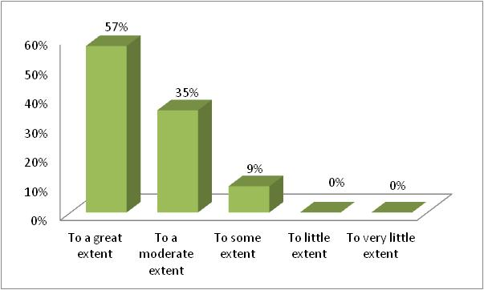
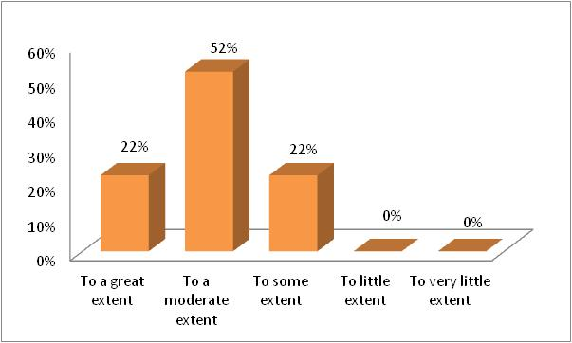
IV. Assessment of the Effectiveness
The charts below show the level of understanding and perceived motivational impact of the sales compensation plans. It is generally regarded that the plans are very well understood; this reflects the viewpoint that the “simplicity of the plan” was the highest rated positive element of the sales compensation plan. However, it would seem appropriate that more than 22% of the sales force would find the program very motivating. In the chart below, 74% (52% moderate + 22% to some extent) view their sales compensation plans as possibly not having the desired impact on the motivation of their sales force.
To what extent do your sales professionals understand the plan and how it works?
To what extent is your sales compensation plan motivating to your sales people?

Slide 69
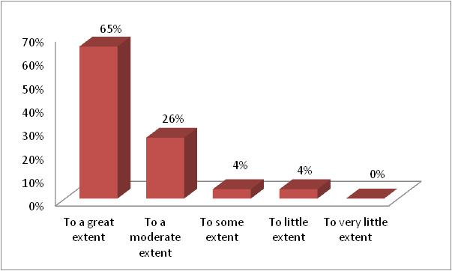
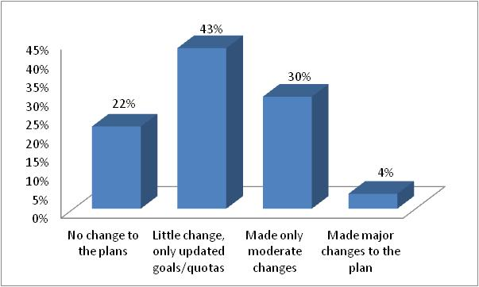
IV. Assessment of the Effectiveness
The charts below show the degree to which the most productive sales people earn the most money and the degree of changes made to the sales plan for 2013. This shows that most companies believe their best people are making the most money; this is a strong indicator of the effectiveness of the plan. Consequently little to no changes were made to the plans coming into 2013. Sixty-five (65%) percent of the companies indicated little change was done. Are there areas for improvement?
To what extent do the most productive sales people earn the most money?
What kind of updates or changes did you make to your 2013 sales compensation plan?

Slide 70
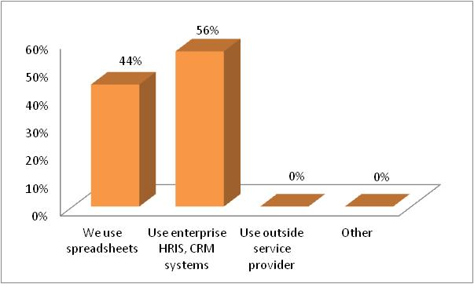
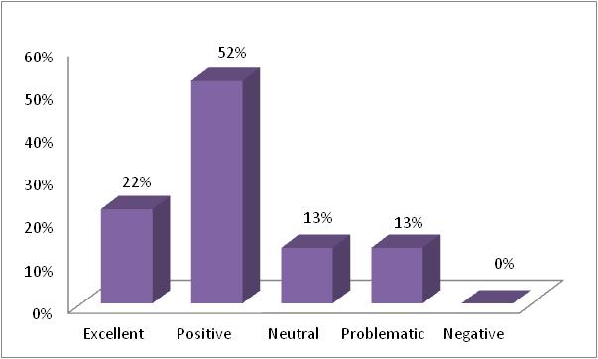
IV. Assessment of the Effectiveness
Administering sales compensation plans are often incredibly time and labor intensive activities especially when the number of sales people increases and the plans become more complex. The charts below show how the participating companies administer their sales plans. Most use some form of HRIS, CRM or similar system. Although they indicated that they do not use external service providers, many firms have adapted external contact management programs to internal uses. The second chart indicates that these plans appear to be working fairly well. Seventy-four (74%) of the companies indicated that the plans were excellent or positive. This perspective is in general alignment about the overall sales compensation plans.
How do you currently administer your sales compensation plans?
How would you assess the effectiveness of the administration of the sales comp plans?

Slide 71
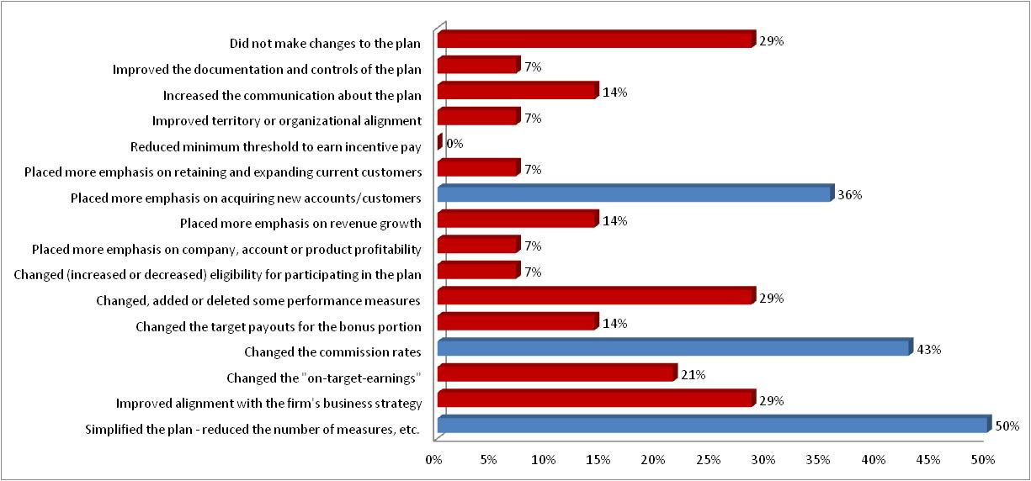
IV. Assessment of the Effectiveness
Most of the participating companies (73%) indicated that they made some changes to their 2012 plans. Those that did make changes, focused on simplifying the plan and aligning the plan to the firm’s strategy and business development initiatives. This apparently was done most directly by changing the commission rates. The overall changes made to the compensation plans for 2013 are shown below:

Slide 72
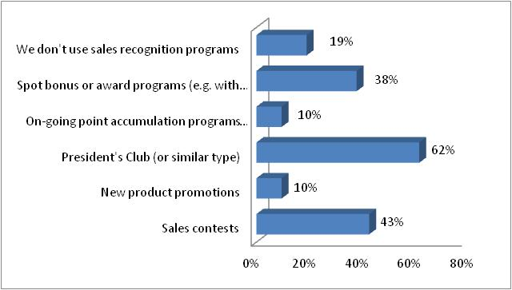
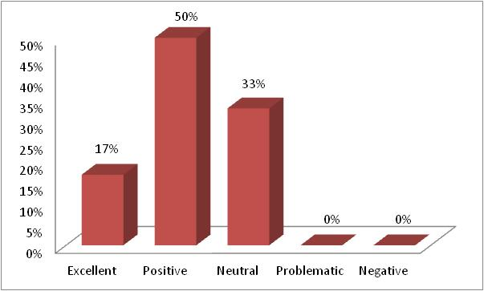
IV. Assessment of the Effectiveness
The charts below show the prevalence and experience with sales performance recognition programs. Approximately 36% of the respondents do not use these type of programs. Those that do, focus these awards on the promotion of new products, increasing sales to new customers, etc.. Companies that use various types of performance recognition programs favor them highly, with 67% indicating their effectiveness was positive to excellent. This indicates that those who currently do not use these programs should examine how they may supplement their current sales compensation programs or their sales growth strategies.
What type of sales performance recognition programs do you use?
How would you assess the effectiveness of these sales performance recognition programs?

Slide 73
IV. Assessment of the Effectiveness
As a final question, we asked the participants to tell us what are the biggest concerns expressed by the sales representatives. They indicated their 3 – 5 most important concerns. The table below shows what these companies believe are the primary concerns of the sales force. The most important factors relate to the goal setting process, the lead generation process, the territory size, and having highly competitive products/services. While this is not unexpected, it does indicate that there are few concerns about the sales compensation plans, but these issues are often magnified by the sales compensation plans. Therefore, the challenge to sales compensation is to assure it is simple to understand, strategically aligned with the company, and integrated with a fundamental and effective sales process.

Slide 74
PART V
Primary Conclusions and Ideas to Consider
Notes:
74

Slide 75
V. Primary Conclusions and Ideas to Consider
We hope that you have enjoyed reviewing this special survey of sales compensation practices. We look forward to improving the survey information to better meet your needs for information and to establish important trends and insights on how companies are structuring their sales compensation programs. We will be doing this survey again next year.
Based on the information presented in this report, we believe there are several things that are important for every organization to consider in making their sales compensation plans more effective for the organization and the sales professionals.
  Examine the measures and assure that they are aligned with the strategy of the organization, and serve to focus and inspire sales professionals to do their very best.
  Create opportunities to reinforce the progress people are making toward their sales goals. The survey data indicated a far less emphasis on performance recognition and performance management programs than we have seen in other organizations. Look for ways to encourage, reinforce and communicate the importance of revenue growth and goal achievement.
  Make the performance–to–pay ratios meaningful to both the individual and the company. The company should look for ways in which the payouts reflect strong growth and profitability to the company; the individual should regard them as a meaningful “return on effort” for their achievements.
  Keep the plan (or plans) simple but not simplistic. It is critical that people understand their compensation plans, and have confidence in the numbers and decisions. Use administrative systems to reinforce the access to timely progress information and create opportunities to reinforce achievements.
  Identify one or two important features of the plan that will give a competitive advantage. Make sure these are important to your sales force as well. Every effective plan has unique elements – what are yours?
If you would like to talk about your sales compensation plans, and explore ways to improve their effectiveness and make a positive impact on the company, please contact us. We would enjoy working with you and building better capabilities and performance in your company.

Slide 76
Overview of the
Wilson Group
Notes:
76

Slide 77
Overview of the Wilson Group
Our Mission:
“To help our clients assess, develop and implement performance systems and
total compensation plans that translate strategy and values into action.”
Our Primary Services:
  Sales effectiveness and total rewards
  Executive total compensation
  Board of directors governance structure and compensation
  Employee total compensation and rewards
  Special studies in market trends and practices
Key Differentiators:
• Our expertise -- Work with highly seasoned, experienced professionals
• Our collaborative approach -- We engage our clients in a collaborative, open communication fashion
• More cost effective -- Highly customized, value added to address just what the client needs
• Innovative insights -- Simplifies complex data into easy to understand information and actions plans
Founded: 1994, Concord, MA
Clients and Markets:
We have worked with over 150 clients. They include:
Information Technology – iRobot, ACME Packet, Constant Contact, TripAdvisor, Care.com
Life Sciences – Cytyc, AgaMatrix, CRF Healthcare
Manufacturing – A.W. Chesterton, MorphoTrust, Dynavac
Professional services – Copyright Clearance Center, Boston Symphony, Morgan Samuels
Financial services – Safety Insurance, Boston Mutual, DentaQuest, Capital Advisors

Slide 78
Overview of the Wilson Group
Leadership Team:
Thomas B. Wilson, President
Susan Malanowski, Principal
Rhonda Farrington, Principal
Plus a team of 5 other experienced professionals
Our Network of additional specialized resources:
Thomas E. Shea & Associates– Executive and Board Compensation
Independent Stock Plan Advisors– Global Equity Compensation
Bostonian Group – Executive and Employee Benefits
Thought Leadership:
Survey of Sales Compensation Practices – 2011 - 2012
“Goal Setting: What Has Gone Wrong and What Can Be Done” – published WorldatWork Journal, Fall, 2011
“Changes for Challenging Times – Survey Report on Economic Challenges and Company Responses” (2009)
Survey Report on Changes in Variable Cash Compensation Plans (2007)
Survey Report on Changes in Equity Based Compensation (2006)
Innovative Reward Systems for the Changing Workplace (McGraw-Hill, revised 2003)
Published over 30 articles and book chapters
Presented at over 100 leading regional and national conferences
Contact us at: www.wilsongroup.com
978-371-0476
801 Main Street, Suite #2 Concord, MA 01742
twilson@wilsongroup.com
smalanowski@wilsongroup.com
rfarrington@wilsongroup.com

